Slide 1

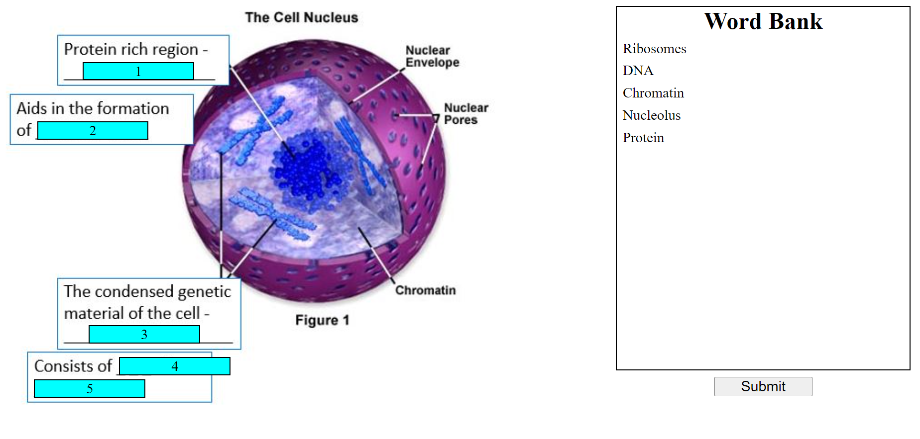
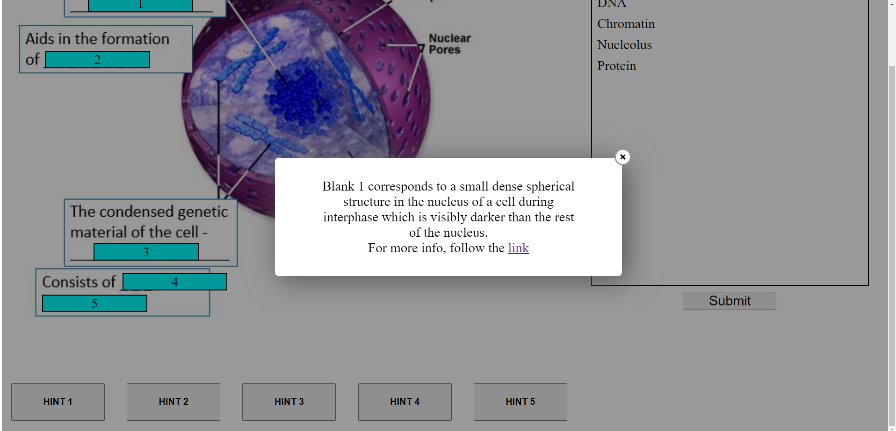
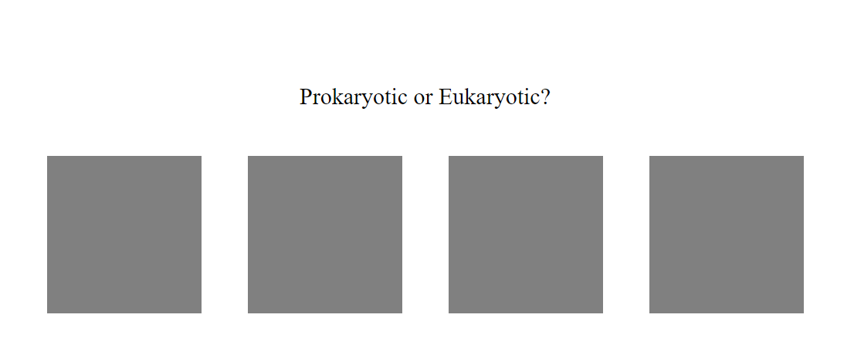
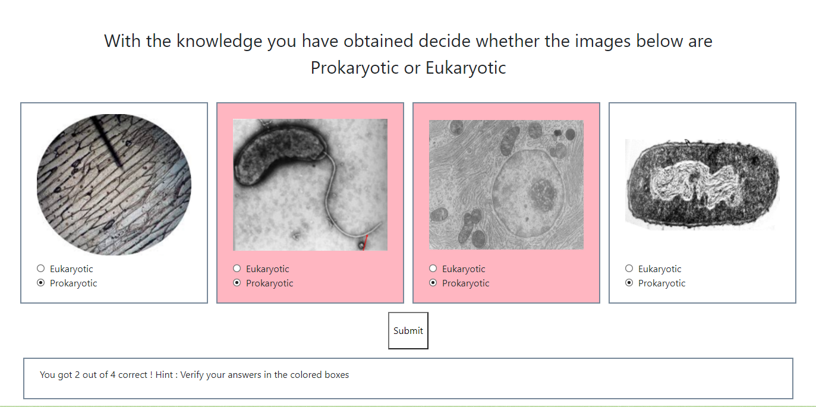
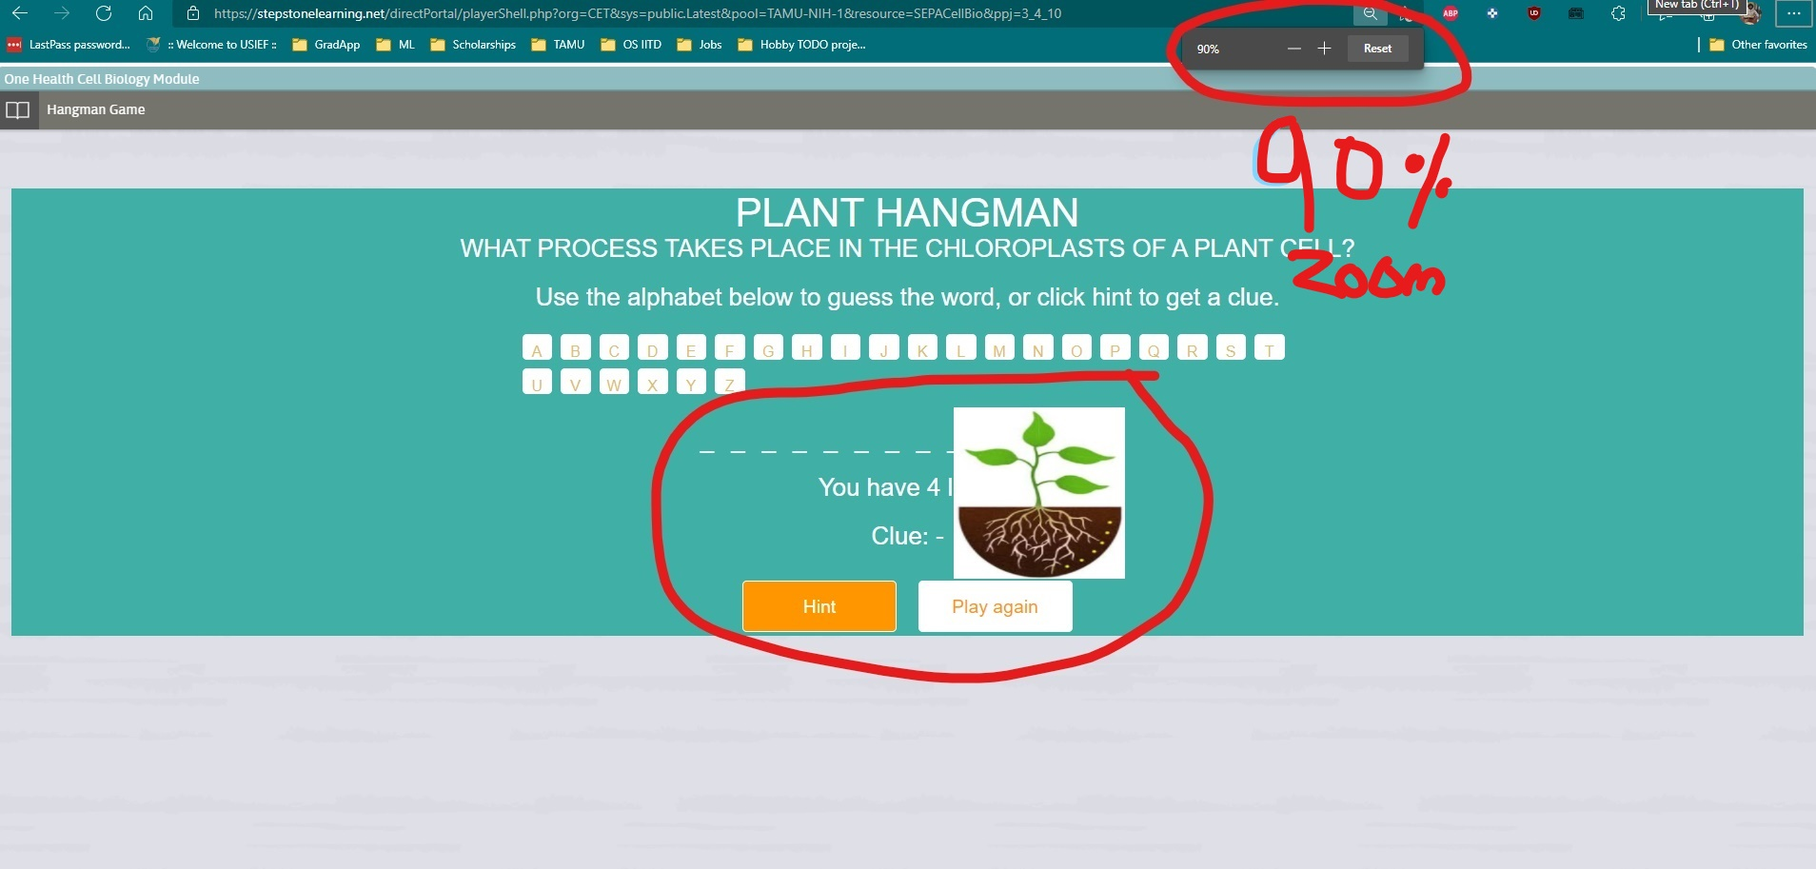
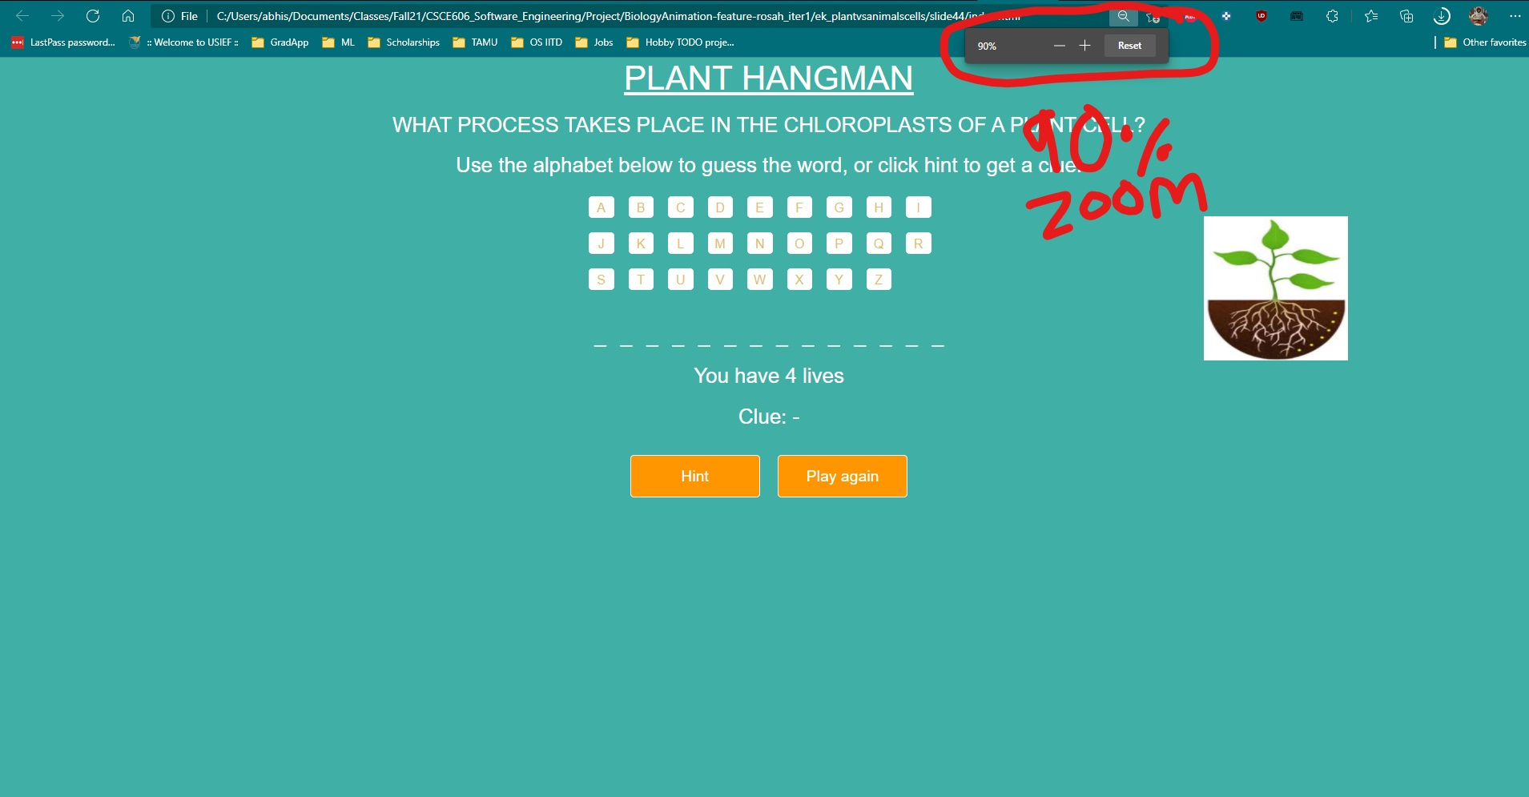
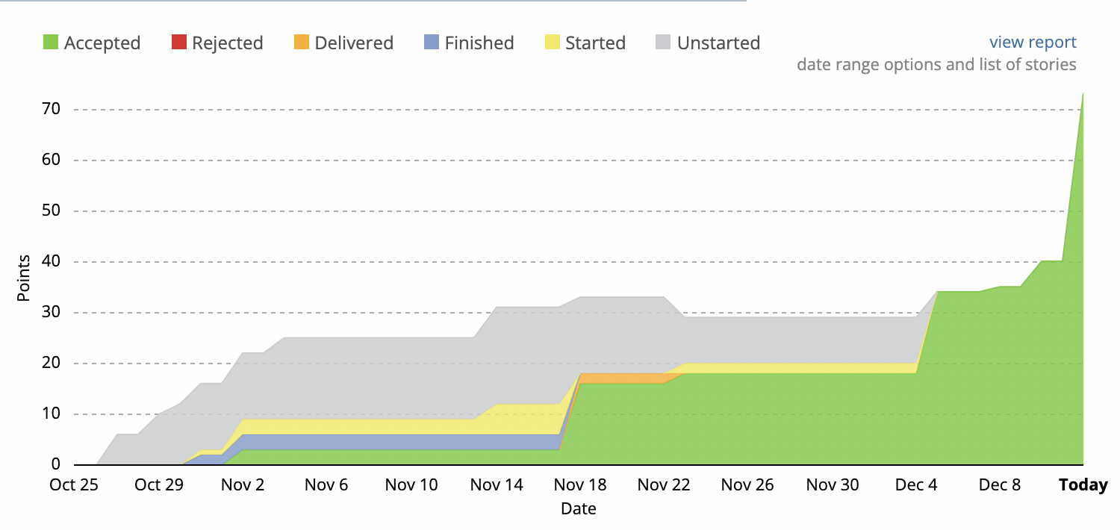
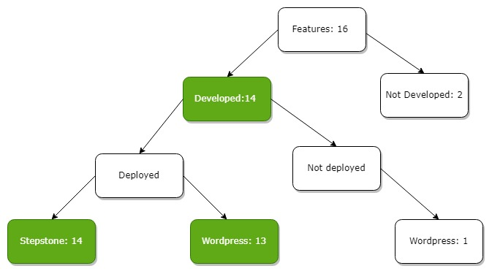
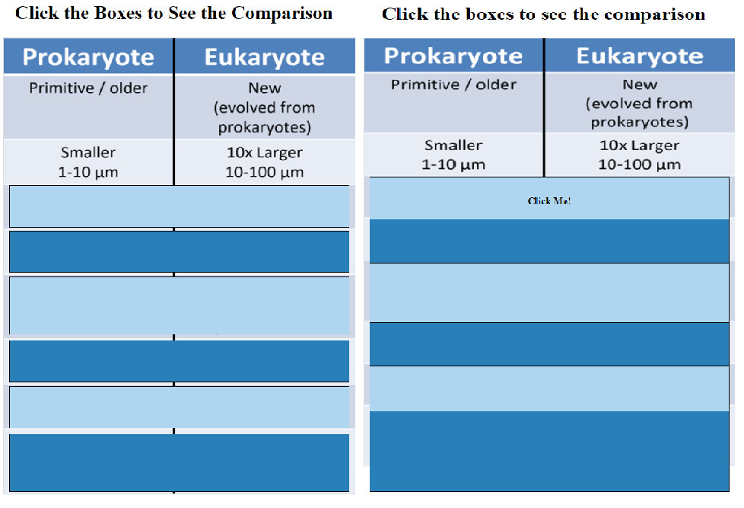
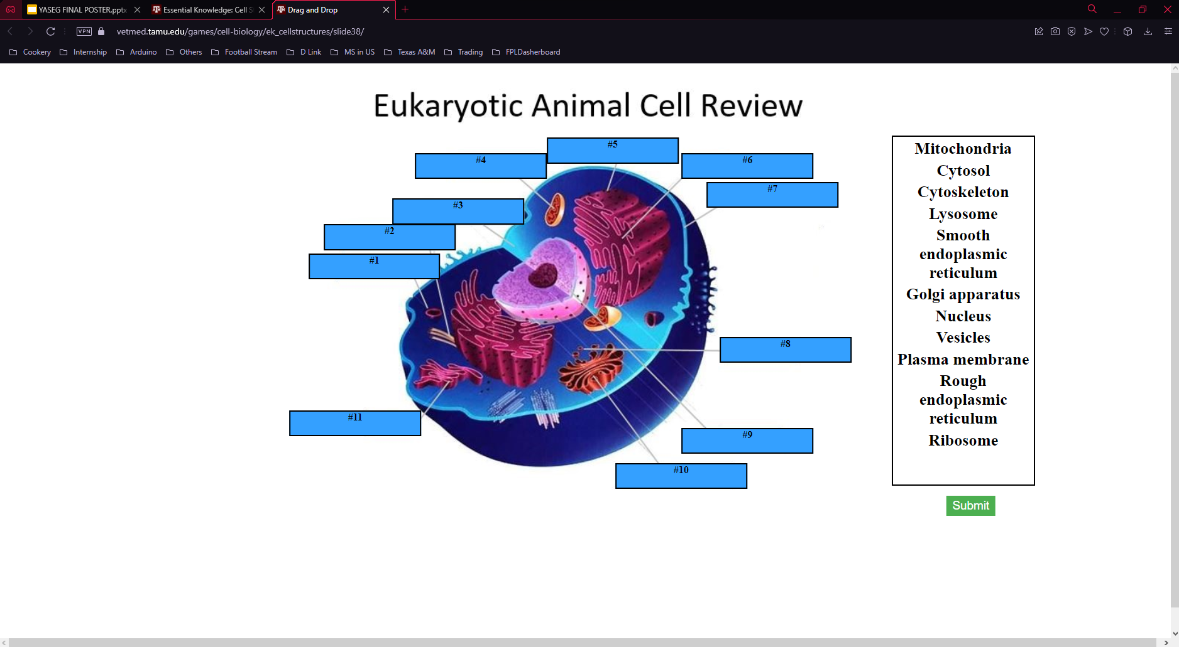
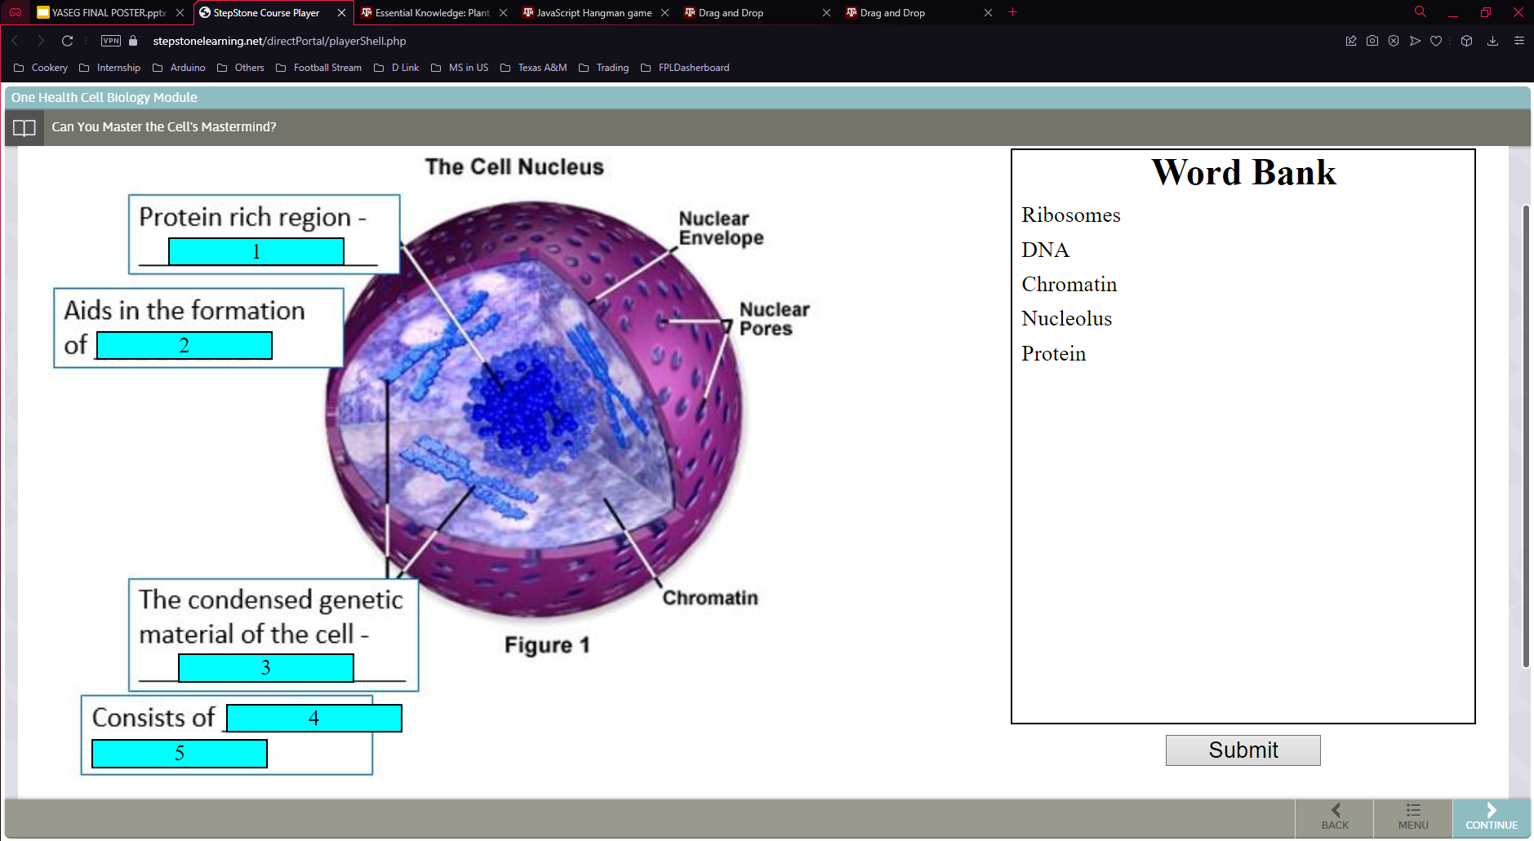
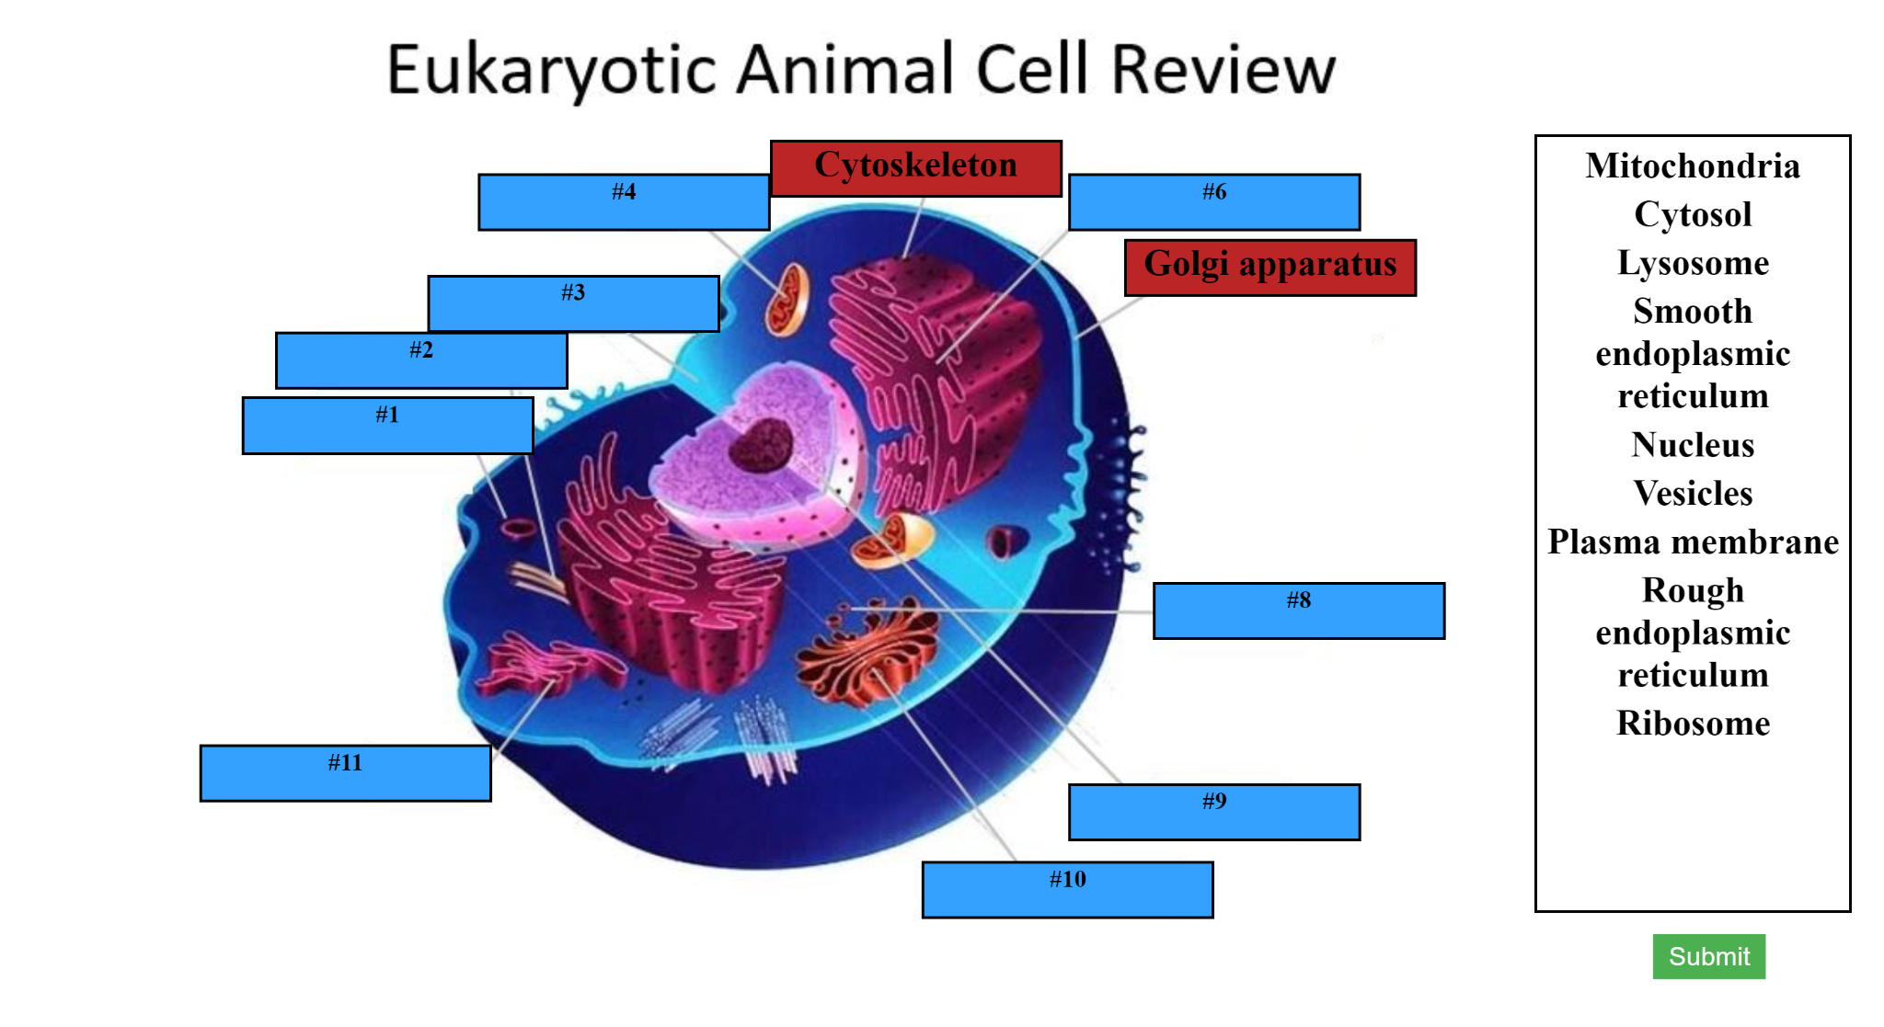
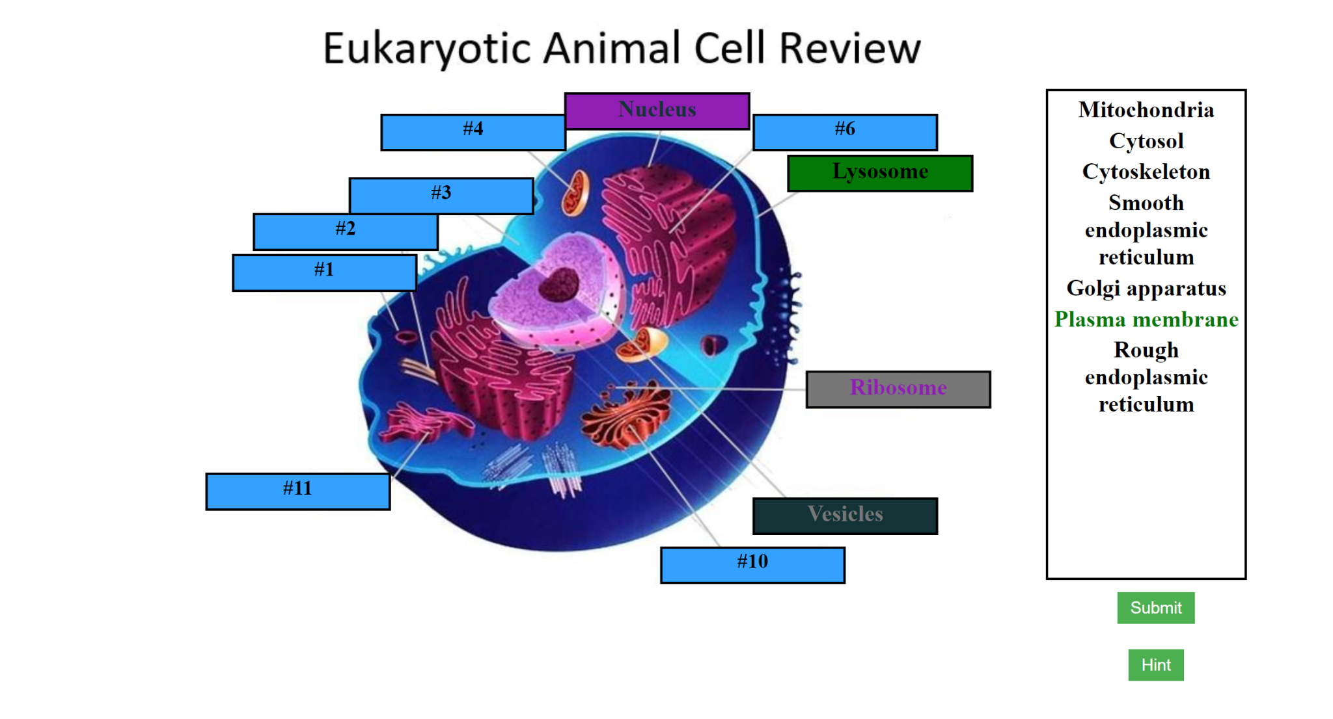
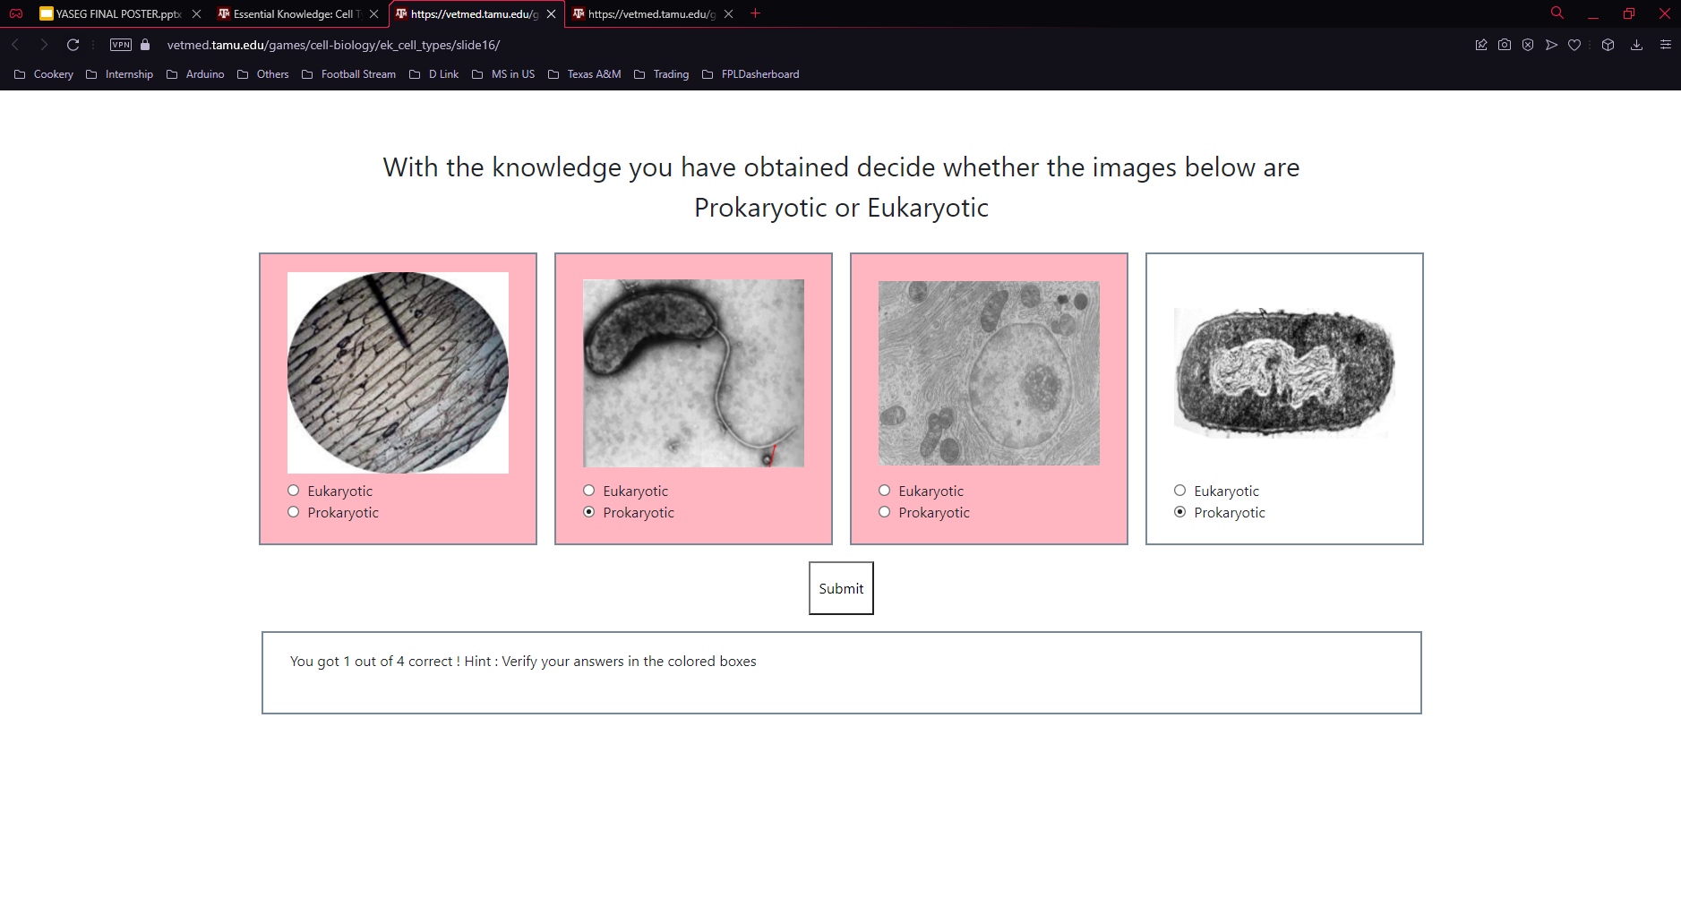
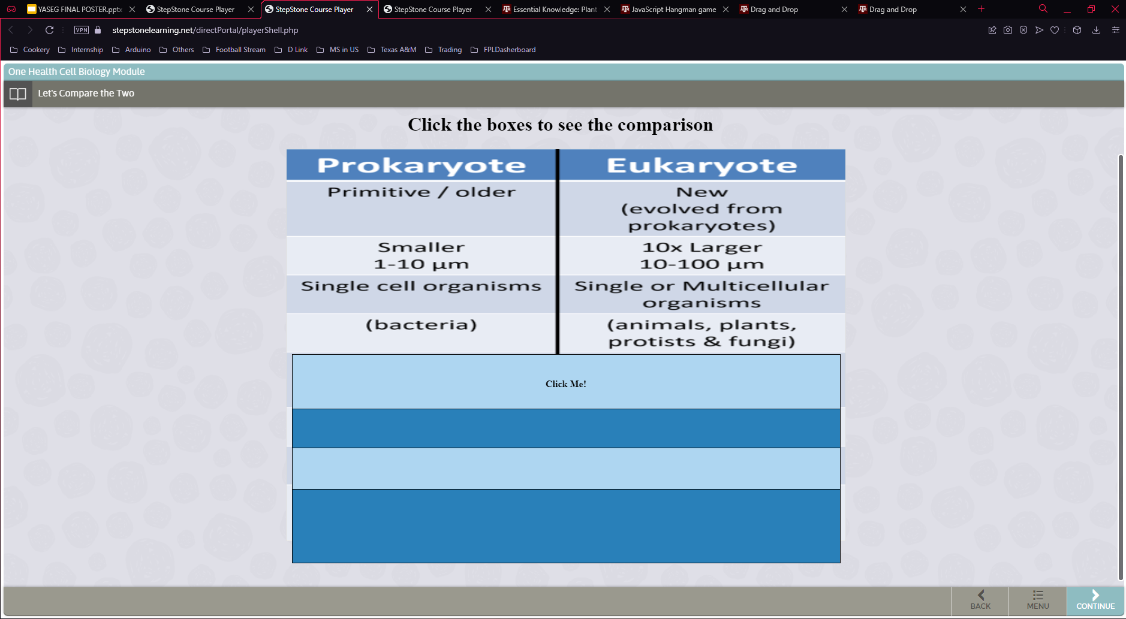
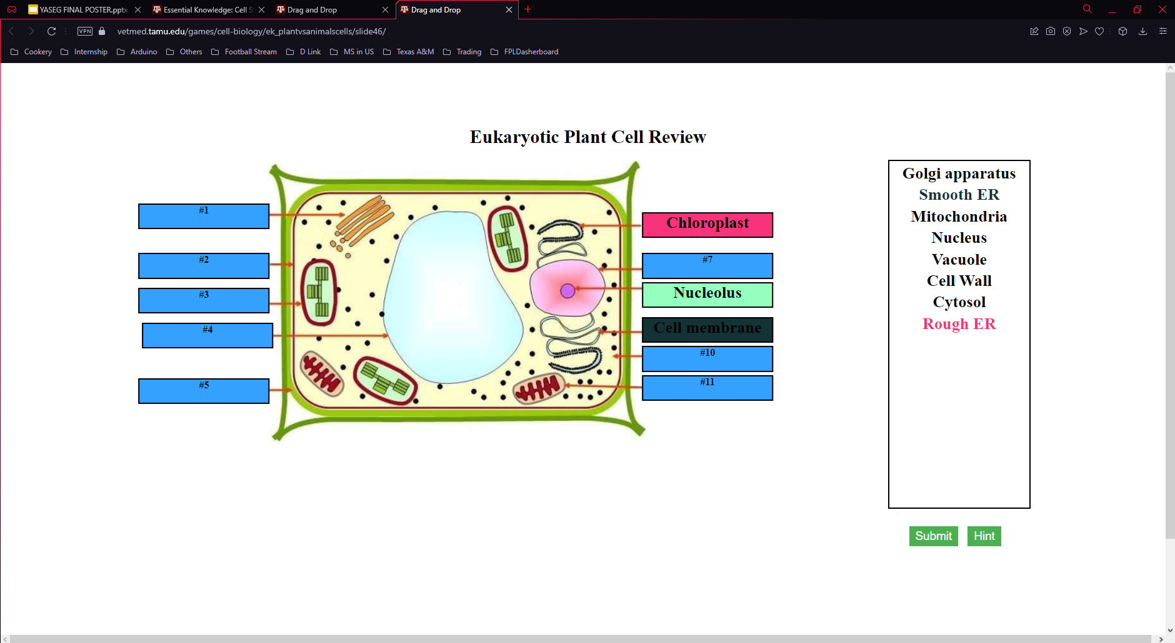
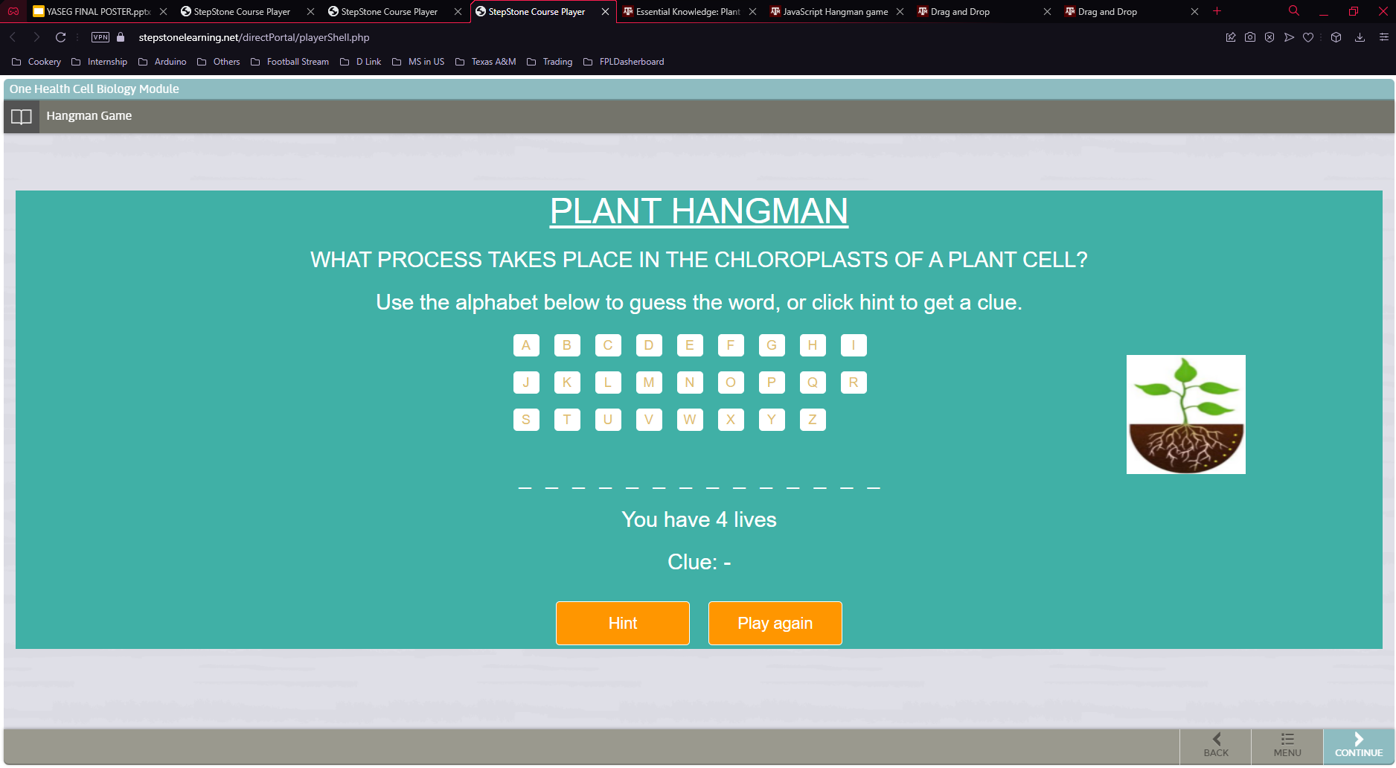
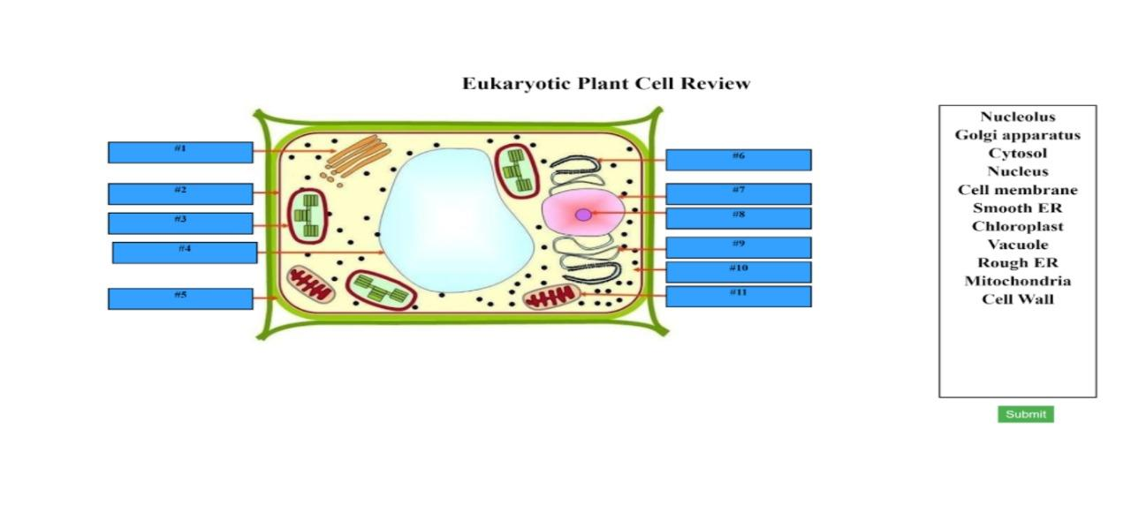
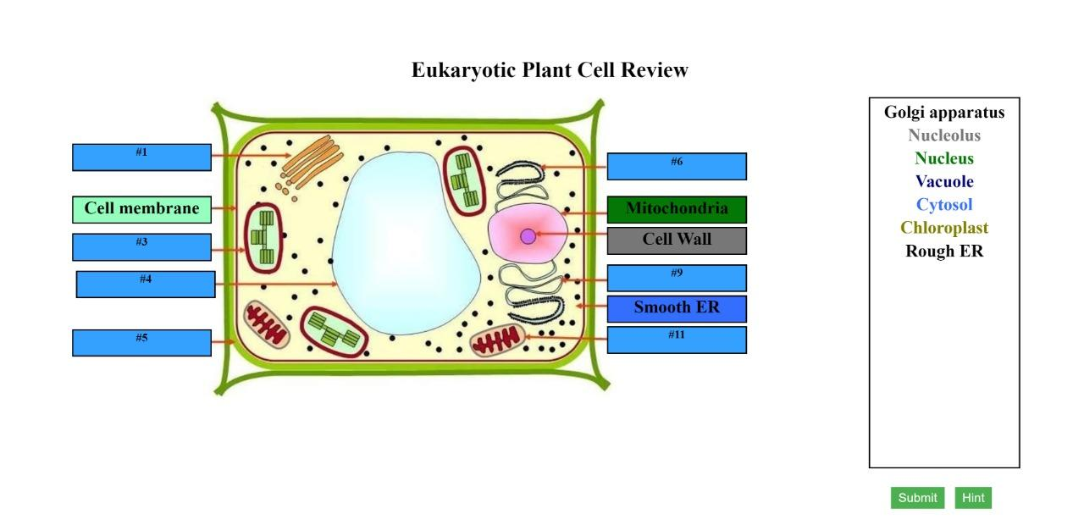
Animations in Cell Biology
Surbhi Thakur, Hemal Mamtora, Rohit Sah, Ganeshprasad Biradar, Abhishek Sinha, Rohan Choudhary, Sherine Davis Kozhikadan
Department of Computer Science and Engineering, Texas A&M University
Introduction
Animation slides
Target customer: VetMed, Dr. Hank Walker
Goal: Aid middle school children to interactively learn biological concepts through games and animations.
Requirement: Enhance JS/JQuery/HTML applications exposed through an existing platform called ‘Stepstone’ and a WordPress based website.
Added ‘click to reveal’ hint system and final hints corresponding to all wrong answers. Figure below shows the previous version and the modified version.
Agile Workflow
ITERATION 0
ITERATION 1
Requirement analysis, gathering inventory
Understanding legacy code
Familiarizing JS. JQuery, HTML & CSS
Verification of existing animations in StepStone and WordPress
Fixing minor responsiveness & interoperability issues
Highlighted incorrect answers and adjusted the exposition. Figure below shows the previous version and the modified version..
ITERATION 2
ITERATION 3
FINAL
Identifying hint system shortcomings
Making animations mobile
compatible
Implemented hint system on the remaining slides.
Collaborating with Samiksha and Daniel for instructions
Deployed on wordpress and step stone.
Final report generation
Generation of velocity plot over time
Corrected the resizing issues, changed the alphabet layout, and made view to be mobile compatible. Figure below shows the previous version and the modified version.
Added Instructions on how to play the game. Figure below shows a comparison between previous and modified version.
This shows our velocity graph. Animations were deployed to StepStone and WordPress environments post Iteration 3, so most of points were accepted only after Iteration 3.
Deployment Snapshots
Improved the UI using color coordination. When hint is clicked, it shows the correct box for the wrong answers. Figure below shows a comparison between previous and modified version.
.
With the new hint system, everytime the user clicks on the hint button, the incorrectly matched boxes are highlighted with the same colour as the correct organelle name.
Goals Achieved / Impact
Acknowledgements
We successfully realized our main goal, which was to make required changes in Cell Biology module and deploy them on Stepstone and Wordpress so to allow students to learn interactively and in an enjoyable way.
We were in constant touch with Daniel Shuta and Samiksha for deployment on Stepstone and Wordpress.
The existing animations have also been made compatible for mobile devices and have been thoroughly tested on Stepstone and Wordpress.
We would like to thank Dr. Hank Walker and Gayathri for their help in verifying our progress and providing inputs throughout the course of the project. We further extend our gratitude towards Daniel Shuta and Samiksha Marne for assisting and enlightening us on deployment related aspects in Stepstone and Wordpress environments.

